Slide 1
ASEAN - German Technical Cooperation Sustainable Port Development in the ASEAN region
Progress Status – SPD
39th APA Meeting
12- 15 November Bali
Franca Sprong

Slide 2
Content
Introduction to GIZ and the Project
Project Partners
Project Indicators
Progress Status
Capacity Building
Technical Assistance
Regional Conferences
Outlook

Slide 3
Our Profile – Deutsche Gesellschaft für Internationale Zusammenarbeit (GIZ) GmbH
Owned by the Federal Republic of Germany
Organised as a private-sector entity
Supports the objectives of the German Government
Operations in 130 countries and employs 17.000
Commissioned by public and private-sector bodies inside and outside Germany
Main commissioning party: the German Federal Ministry for Economic Cooperation and Development (BMZ)

Slide 4
The Project
The GIZ implements the project in cooperation with APA and is financed by BMZ, with a total budget of 5 million EUR (2009 – 2015)
Part of a regional programme ‘Cities, Environment and Transport’
Overall project objective:
“Selected ports have improved the quality and efficiency of their Safety, Health and Environmental (SHE) management”
Overall project impact:
“The quality of life and welfare of port workers and nearby communities has improved”

Slide 5
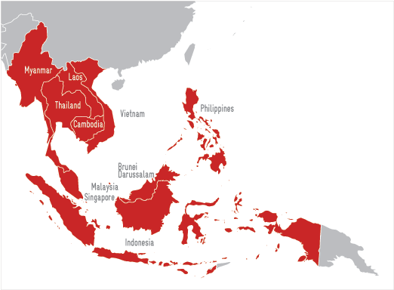
Participating Ports
Iloilo
Cagayan de Oro
Bangkok
Laem Chabang
Sihanoukville
Phnom Penh
Saigon Port
Saigon Newport
Tanjung Priok
Sabah Ports
Johor Port
Yangon Port

Slide 6
Project Indicators
Four ports have implemented at least three measures to reduce an industry-specific environmental impact
Participating ports of two ASEAN countries implemented the management of ships’ waste in accordance with MARPOL Annex V in consultation with the national level, port authorities and waste disposers
Six ports have introduced a system for incident/accident rates registration (including reporting and investigation)
At least six ports had their PSHE Management System audited following international standards (PEMSEA PSHEMS, ISO14001, OHSAS 18001)
Proposals to ensure project results are sustainable, discussed and documented

Slide 7
Reaching the Indicators
3 ports have had their PSHE Management System audited, with 3 ports expected to be certified by 2015 (CDO, PPAP and PAS)
Bangkok Port has introduced a new system for accident/incident registration, Saigon Port and Saigon Newport expected to have the system ready by the 1st quarter of 2014
At least 7 ports have taken selected initiatives on air emissions, waste management and organizational changes to reduce their environmental impacts
Laem Chabang Port is on their way towards the management of ships waste in accordance with MARPOL 73/78 through support from the project

Slide 8
Progress Status Capacity Development
Notes:
Add picture

Slide 9
Training in Philippines and Cambodia
Advanced Course on the Handling of Dangerous Goods in Port Areas, for Cagayan de Oro port and the Department of Labour and Employment (DOLE)
Training Modules in the Philippines PPA Training Centre - 40 participants – by project trained trainers
SPD1 – Handling of Dangerous Goods in Port Areas – General
SPD5 – Basic Safety, Health and Environment Issues
SPD6 – Occupational Safety and Health in Ports
Phnom Penh Port redelivered Handling of Dangerous Goods in Port Areas
Notes:
Add picture

Slide 10
Study Visits to Germany
Malaysian ASEAN Ports Association (MAPA) Study Visit to Germany
Study tour in June 2013 for MAPA organized in cooperation with GIZ State Office Hamburg and the project, self financed by MAPA
13 representatives learned best practices on port management, sustainable port development and SHE management
Vinamarine Study Visit to Germany on MARPOL Annex VI
Organized in cooperation with GIZ State Office Hamburg in October, self financed by Vinamarine – October
6 officials visited governmental agencies and institutes to discuss MARPOL Annex VI, Regulations, Maritime Emissions, IMO initiatives

Slide 11
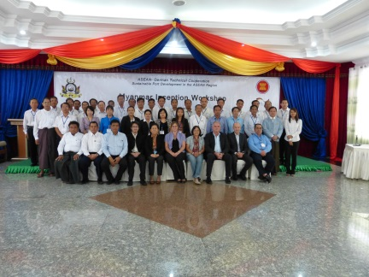
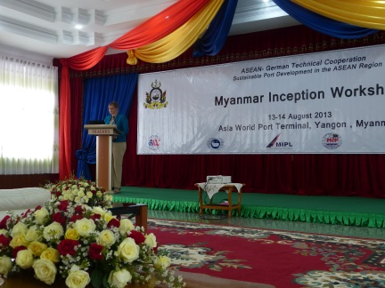
Inception Workshop – Myanma Port Authority (MPA) Yangon
13 – 14 August hosted by Asia World Port Terminal (APWT)
The project presented the objective, strategies and approach / shared and discussed main issues in the maritime sector
Forty participants from the MPA, Department of Marine Administration (DMA) and various terminal operators
Possible activities and outputs developed for future cooperation
Notes:
Add picture

Slide 12
Progress Status Technical Assistance
Notes:
Add picture

Slide 13
PSHEMS Development in partnership with PEMSEA
Iloilo, Bangkok and Laem Chabang – received recognition by PEMSEA
Sihanoukville
Cagayan de Oro
Phase 6 Continual Improvement, review of achievements
Phase 5
Port Safety Health and Environmental Management System Auditing
Phnom Penh
Phase 4
Implementation of the policy, programs and procedures, measurement of the performance
Phase 2
Identification of hazards, risk assessment. Development of objectives, targets, programs
Phase 3
System development and Documentation (manuals and procedures addressing identified risks)
Phase 1
Review of existing processes and structure
Notes:
Add picture

Slide 14
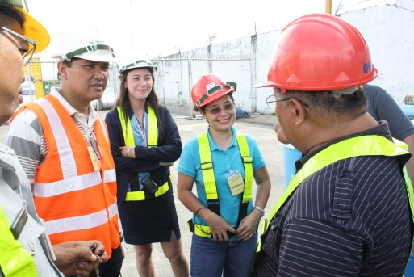
SHE Policies, Rules and Regulations at the PPA
Situational and Gap Analysis for Philippine Ports carried out by REID Research, Education and Institutional Development Foundation
The Philippine Ports Authority (PPA) wishes to update SHE policies
The PPA and SPD developed a work plan and approach on update SHE policies, rules and regulations for the Philippine ports
Expected output of the PPA ‘Orange Book’ on SHE rules and regulations
Notes:
Objective is to support the Department of Transport and Communications (DOTC) regarding transposing maritime international conventions into national law
Analysis of current situation in Philippines
Identified gaps of ratified international conventions and conventions needed to be ratified
Commissioned to the Research, Education and Institutional Development (REID) Foundation

Slide 15
Initial Status Review at Yangon Port, Myanmar
ISR conducted in 8 terminals, under the jurisdiction of the MPA in early October (Yangon Port area and Thilawa Port area)
Reviewed the performance of SHE management, existing systems and procedures and provided areas for improvements / recommendations
Recommended to develop SHE policy and management guidelines based on internal codes and conventions
MPA and SPD will draft workplan
Create SHE awareness through capacity building with Yangon Port staff
Notes:
Add picture

Slide 16
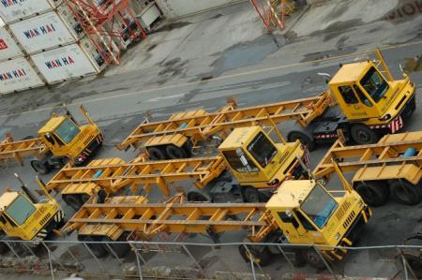
Environmental Procedures and Accident Reporting in Bangkok Port, Port Authority of Thailand
various trainings on accident reporting, inspection and safety procedures supported the Port Authority of Thailand (PAT) to develop a new accident reporting format, approved by the Ministry of Transport
Advice on restructuring of Environmental Unit for PAT
Environmental quality monitoring and suggestions for improvements are on going
Notes:
Add picture

Slide 17
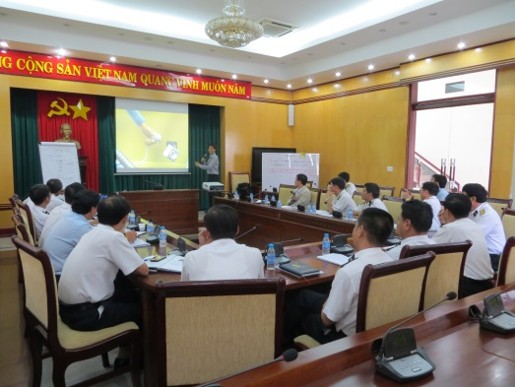
SHE Awareness and Capacity Building in Saigon Port and Saigon Newport
Technical assistance on SHE issues were discussed and action plan developed with Saigon Port
A workshop to support Saigon Newport on Safety Management organized in August focused on HIRARC, accident reporting and port safety inspection
Agreed action plan for support to Saigon Newport
Notes:
Add picture

Slide 18
Assessment in the Port of Tanjung Priok (Terminal III)
Following the 2010 ISR and early 2013 baseline study, an in-depth assessment of the current condition of Terminal Operation III was conducted from 30 Sept – 1 Oct (as a pilot terminal)
The assessment report will be used as a basis for developing policies to improve SHE management
Best practices from the pilot activities to become main reference for future policy development on SHE for other terminals in TP and used as a main input for development of the IPC Roadmap towards sustainable ports
Notes:
Add picture

Slide 19
Progress Status Regional Conferences
Notes:
Add picture

Slide 20
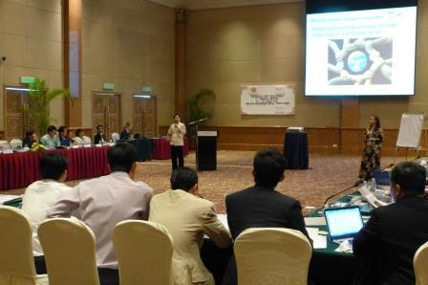
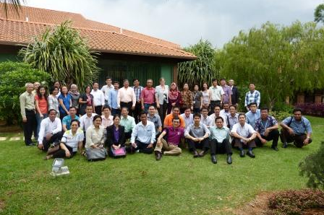
7th Regional Project Progress Review and Planning Meeting, Johor, Malaysia
The project organized the 7th Regional Meeting on 20 – 22 August, hosted by Johor Port Authority
As a continuation of six regional meetings in the past 4 years
Serves as a platform for the ports, national level and the project to review results and achievements
After the meeting, a detailed work plan with goals and objectives was established
Notes:
Add picture

Slide 21
MTWG and ASEAN OSHNET
Attended the ASEAN – Maritime Transport Working Group meeting in Myanmar 20 – 22 August 2013
Presented and updated the meeting on project progress and results
Promoted the roundtable discussion between the MTWG and ASEAN OSHNET to discuss issues to collaborate in the area of Occupational Safety and Health in ports
Notes:
Add picture

Slide 22
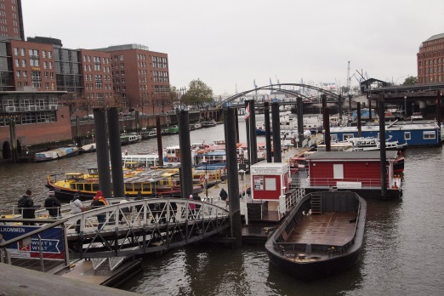
Outlook – Capacity Building
Training for port authorities on Port Management and SHE on 4 – 15 November in cooperation with Bremen Port – Indonesia
Course Instructors Workshop in Manila, Philippines 18 – 22 November
SHE Awareness Workshop – VINAMARINE Hanoi, Vietnam 18 November
Green Port Policy Development and Stakeholder Analysis in Johor Port Authority December 2013

Slide 23
Outlook – Technical Assistance
Support Saigon Port and Saigon Newport on Safety Management
Continual support to Tanjung Priok on Safety Management Systems
Environmental Monitoring in Bangkok Port November – April 2014
Support the enhancement of SHE Policies, Rules and Regulations at the Philippine Ports Authority (PPA)
Support Bangkok Port in October (1) accident reporting and investigation with primary focus on improvement (2) gap assessment of environmental management
Revision of tasks and responsibilities of the Environmental Units

Slide 24
Outlook – Regional Conferences
Participation in the 6th APEC Port Services Network (APSN) Council Meeting in November 2013
Participation in UNESCAP Asia Ministers meeting on Dry Ports Agreement / Marketplace for Sustainable Transportation in November
Participation in the Pan Bei Bu Gulf Regional Cooperation Project – Ports Cooperation Roundtable in November
Organizing workshop entitled ‘Driving Change for Sustainable Ports’ – BKK, Thailand
High level meeting ASEAN OSH Net and the ASEAN Maritime Working group May 2014
Support to workshop organised by Thailand (management systems) and Brunei (environment ports and shipping) in 2014

Slide 25
Implemented by
As a federal enterprise, GIZ supports the German Government in achieving its objectives in the field of international cooperation for sustainable development.
Published by Deutsche Gesellschaft für Internationale Zusammenarbeit (GIZ) GmbH
Registered offices, Bonn and Eschborn, Germany
ASEAN – German Technical Cooperation
Sustainable Port Development
in the ASEAN Region
E franca.sprong@giz.de I www.SustainablePort.org
Responsible Franca Sprong
In cooperation with

